Slide 1
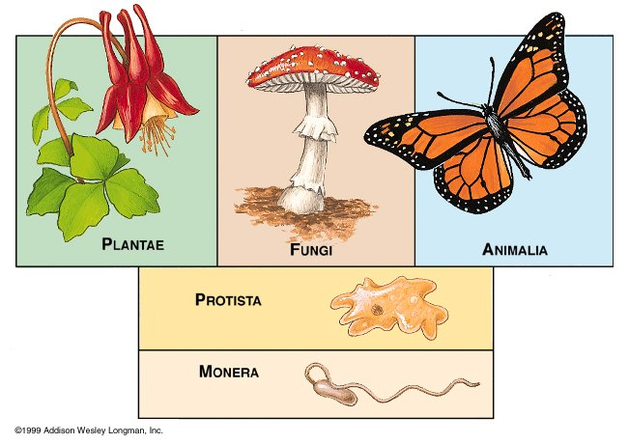
Classification of Organisms
The most basic category of organisms is called a kingdom.
Most scientists divide organisms into five major kingdoms.
The five kingdoms are the Monera (Bacteria) Kingdom, the Protist Kingdom, the Fungi Kingdom, the Plant Kingdom, and the Animal Kingdom.

Slide 2
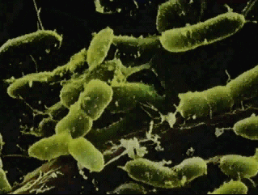
Kingdom Monera/Bacteria
The Monera Kingdom consists of unicellular lifeforms.
Unicellular means that they only have one cell.
These cells have no nucleus, and are also missing many of the organelles, or parts, commonly found in other cells.

Slide 3
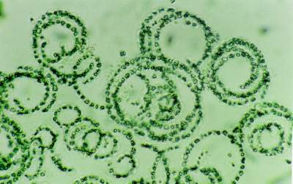
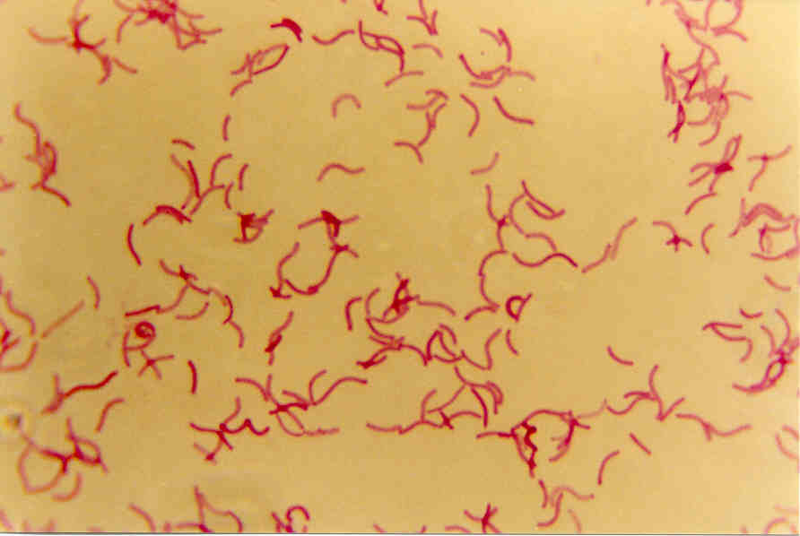
Kingdom Monera/Bacteria
Monerans include all bacteria and one type of algae: blue-green algae.
There are two
types of bacteria:
Archaebacteria
and Eubacteria.

Slide 4
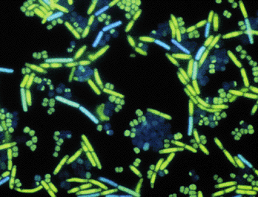
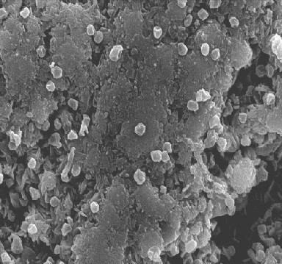
Kingdom Monera/Bacteria
Archaebacteria are an ancient line of bacteria that live in extreme environments such as hot thermal vents.
Eubacteria, or “true
bacteria,” can be either
harmful or helpful to
other organisms.

Slide 5
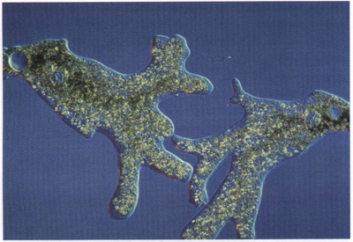
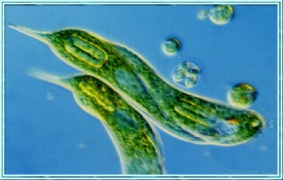
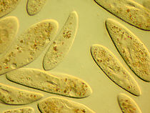
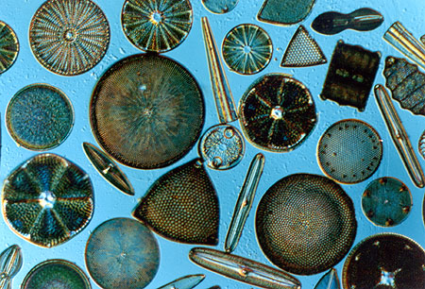
Kingdom Protista
The Protista Kingdom consists of unicellular life forms (life forms with only one cell) who have a nucleus.
Examples of protists are amoebas, euglenas, paramecia, and diatoms.

Slide 6
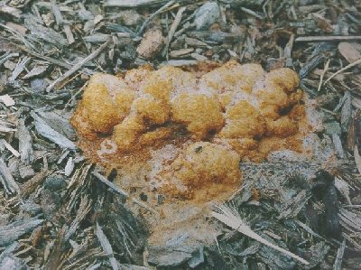
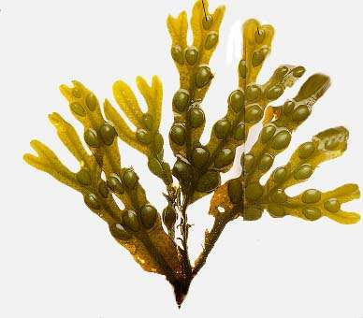
Kingdom Protista
The primary difference between protists and moneras is that protists are more complex, having a nucleus.
Many protists appear to be both plant and animal. Like plants, they are green, and can create their own food. However, like animals, they have moving body parts, and are able to move around their environments.

Slide 7
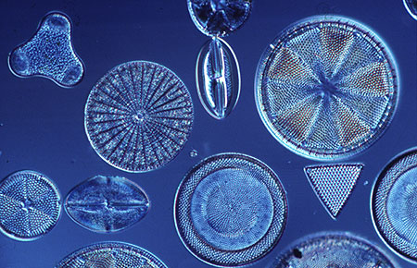
Kingdom Protista
Click on the picture of the diatoms to see
a video clip about the Protist kingdom.

Slide 8
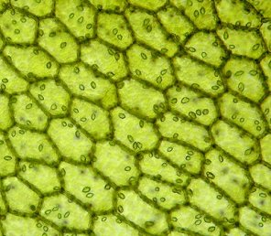
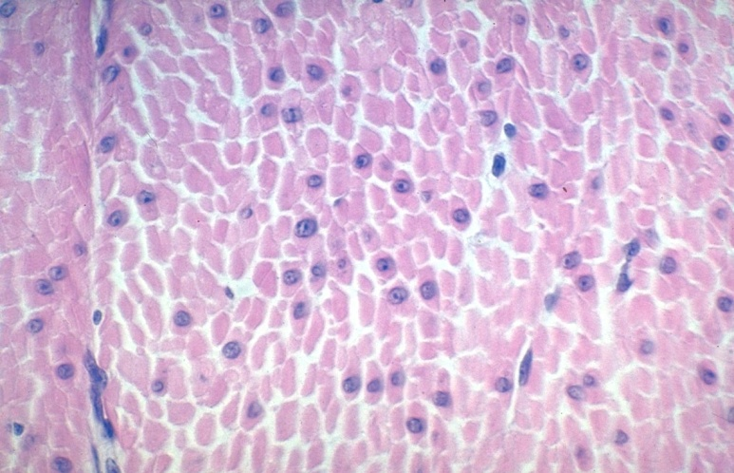
Multicellular Organisms
The final three kingdoms contain organisms that are truly multicellular.
They all have different types of cells that each perform special functions and work together to keep the organism alive.

Slide 9
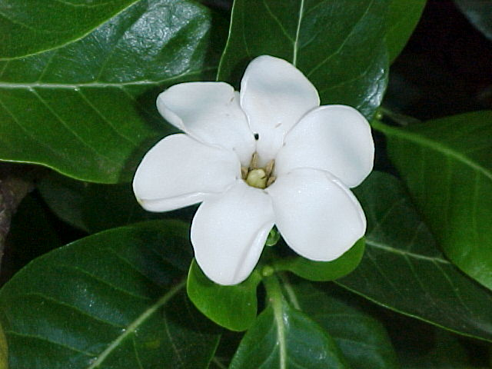
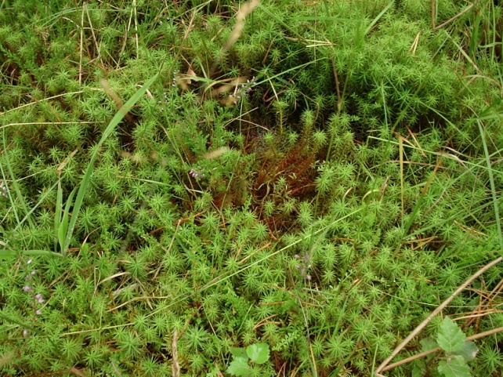
Kingdom Plantae
The members of the Plant kingdom are all producers.
This means that they can make their own food through the process of photosynthesis.

Slide 10
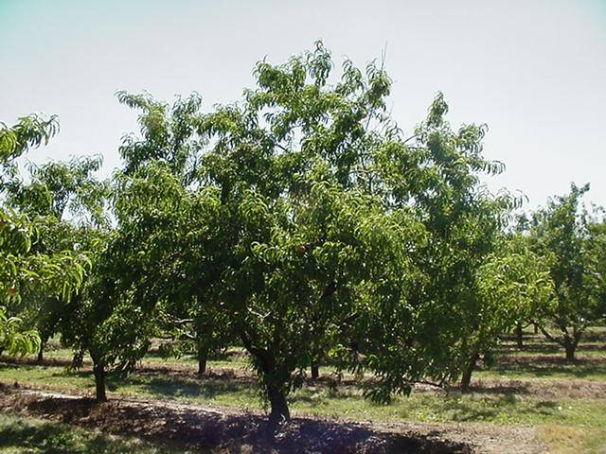
Kingdom Plantae
Plants use the light from the Sun to produce their own food.
Plants get their green color from the chlorophyll to collect energy from the light of the Sun.
They then use this energy to create food.

Slide 11
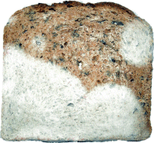
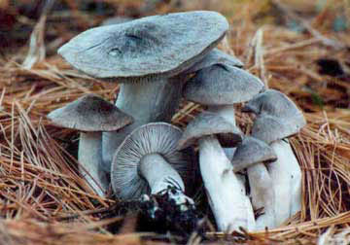
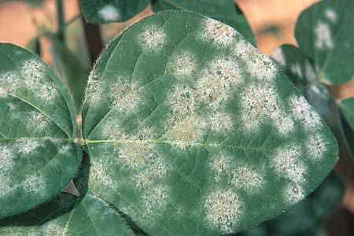
Kingdom Fungi
The members of the Fungus kingdom are all decomposers that use spores to reproduce.
Some examples are mold, mildew, and mushrooms.

Slide 12
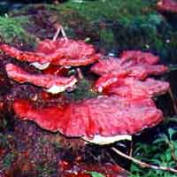
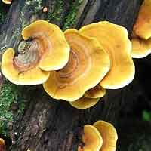
Kingdom Fungi
The members of the Fungus kingdom are all decomposers that use spores to reproduce.
Unlike plants, fungi cannot make their own food.
Some examples are mold, mildew, and mushrooms.

Slide 13
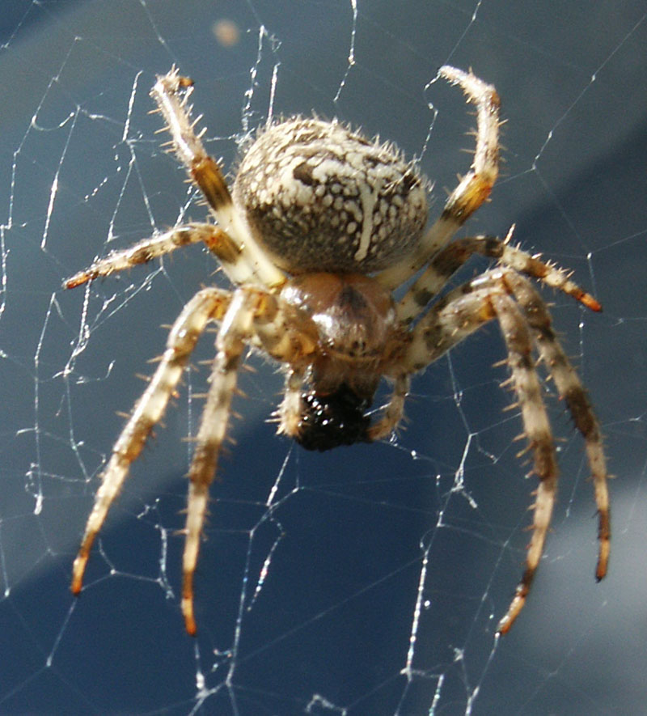
Kingdom Animalia
The members of the Animal kingdom are all consumers.
This means that they get their food from other organisms by eating them.

Slide 14
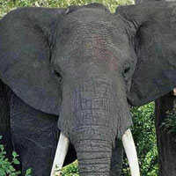
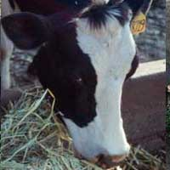
Kingdom Animalia
Animals have tissues, organs and organ systems.
Animals cannot make their own food. Without other food sources, animals could not survive.

Slide 15
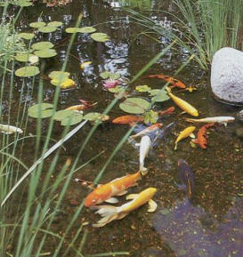
Now Let’s Review!

Slide 16
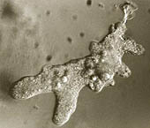
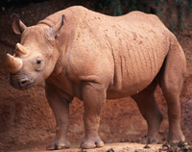
Cellular Organization
Unicellular organisms contain only one cell.
Multicellular organisms are made of many cells.

Slide 17
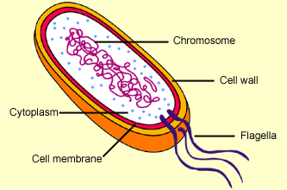
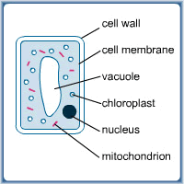
The Two Types of Cells
Prokaryotic cells:
cells that do not have a nuclear membrane around the DNA
Eukaryotic cells:
cells that have a true nucleus containing the genetic material

Slide 18
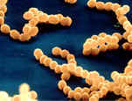
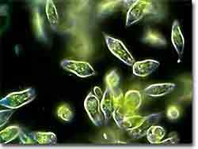
Unicellular Kingdoms
Unicellular organisms that are prokaryotic
KINGDOM MONERA
Unicellular organisms that are eukaryotic
KINGDOM PROTISTA

Slide 19
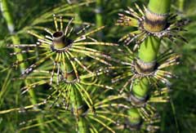
Multicellular Kingdoms
Multicellular producer=
KINGDOM PLANTAE
ALL multicellular organisms contain eukaryotic cells.

Slide 20
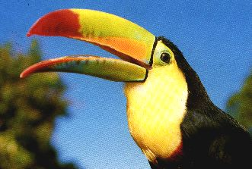
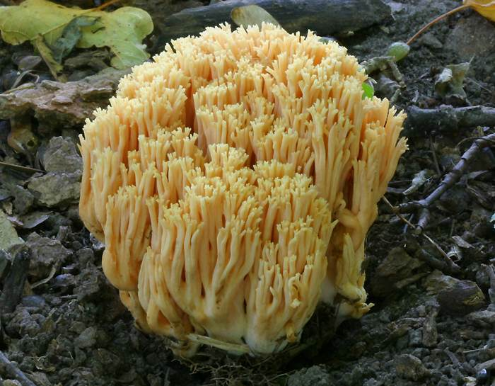
Multicellular Kingdoms
Multicellular consumer
KINGDOM ANIMALIA
Multicellular decomposer
KINGDOM FUNGI

